Slide 1
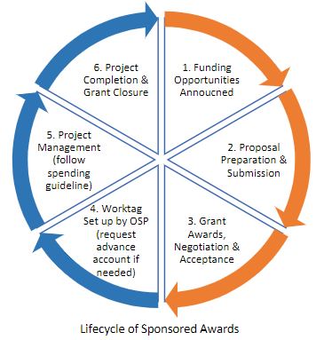
Your ONR Support
Post-Award Pre-Award
Ashley McFadden – Pre-award
Stephanie Baca – Post-award
Souad Benloukil – Clinical Research Coordinator
Program Coordinator/Admin Assistant – Niranga Subasinghe
Contact us at:
nurs-ONR@virginia.edu

Slide 2
What’s New? 1. Huron – AKA ResearchUVA Powered by Huron (RUVA PBH) 2. Workday Financials

Slide 3
Huron
RUVA PBH is the new system used to submit proposals and post award actions that require OSP and/or sponsor approval as well as non-funded agreements (NFAs).
PIs can use Huron to track their own proposals and awards as well as some limited reports or forms (NIH Other Support).
Huron will be the main conduit of communication between the Schools and OSP.

Slide 5
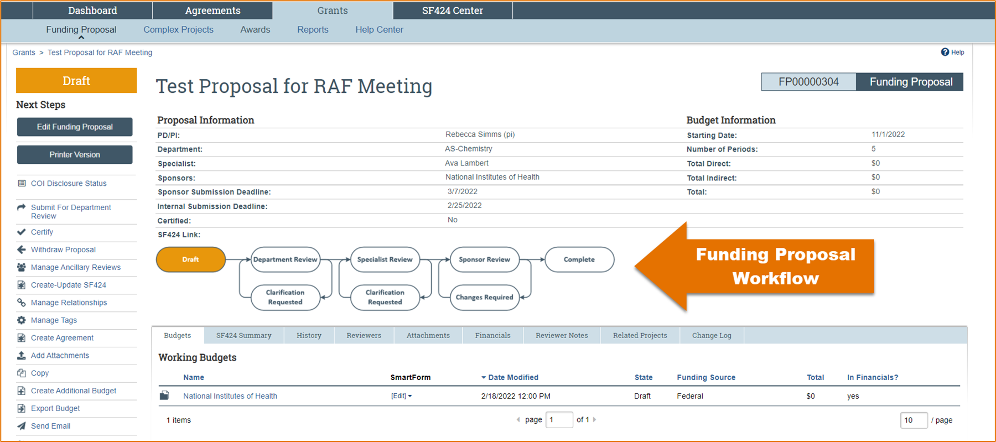
Funding Proposals in Huron - Workflow

Slide 6
Reporting Functions

Slide 7
WorkDay It’s all about access!
You must request “Finance Reporting Reviewer” role in WD in order to see your grant balances and expenditure details
This does not replace your ONR support, we’re here for you!
We will offer brown bag sessions to go over WD grant reports and how to access as well as understand them

Slide 8
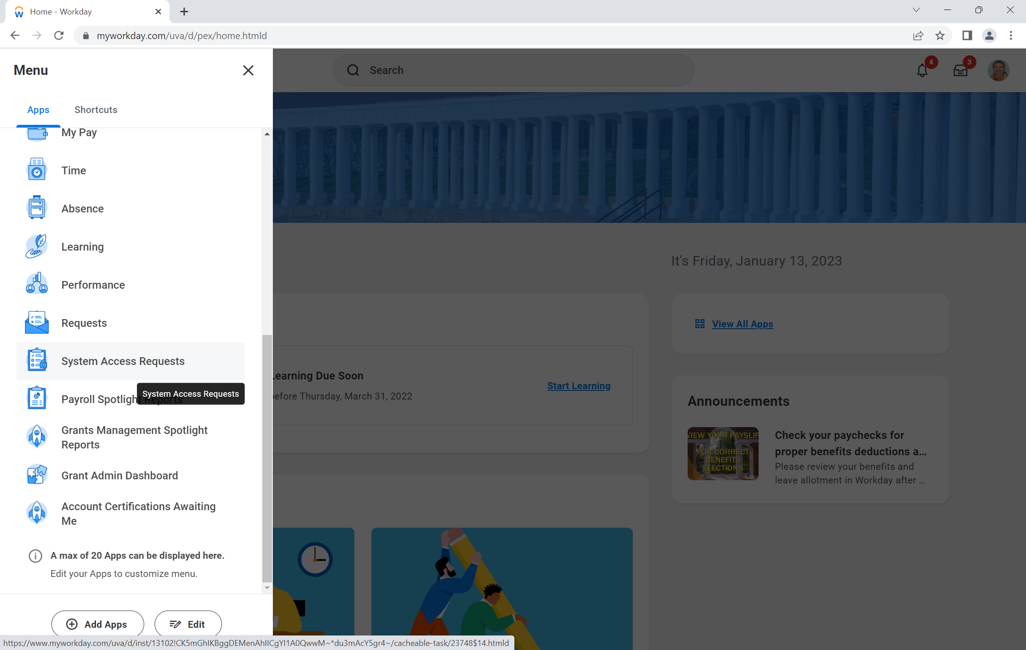

Slide 9
